Slide 1

Airplane RISK ANALYSIS

Slide 2

Overview
Our company is intending to expand its business portfolio by entering new industries. Although the stakeholders are unaware of the risks involved, they are eager to own and operate aircraft for the commercial and private sectors. The main goal of this project is to determine the least danger-prone aircraft models which eventually become eligible for purchase by the company.

Slide 3
Business Understanding
Our company is expanding its portfolio by venturing into the aviation industry.
Since we are unaware of the risks associated with various aircraft models, this project aims to identify the lowest-risk aircraft.
This will help minimize potential operational risks and ensure a secure investment.

Slide 4
Data Understanding
The dataset used for this analysis is from the National Transportation Safety Board that includes aviation accident data from 1962 to 2023 about civil aviation accidents and selected incidents in the United States and international waters.

Slide 5

Data Analysis
There was a significant increase in accident cases after 1980, but the number of cases has been decreasing ever since then.
There is also a significant increase on incidents from 1980 and seem to remain constant

Slide 6
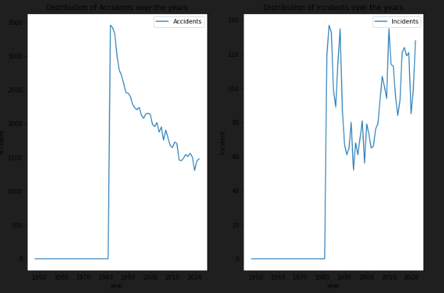
Data Analysis (contd.)

Slide 7
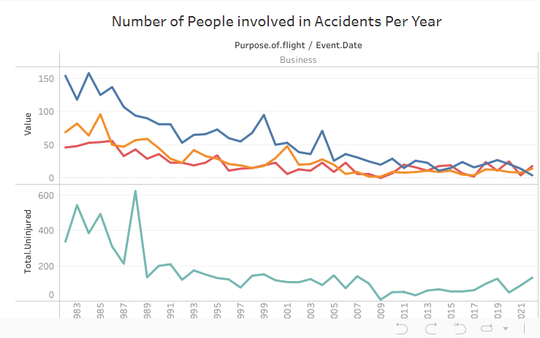
Data Analysis (contd.)

Slide 8
Total uninjured involvement has the highest counts most years, though it fluctuates significantly.
Fatal injuries tend to have lower but relatively consistent annual numbers compared to other severity levels.
There are noticeable spikes in total injuries (across severities) in certain years like 1996, 2001, and 2009, possibly indicating major incidents in those years.
There is an increasing trend of cumulative injuries over the time period analyzed.

Slide 9
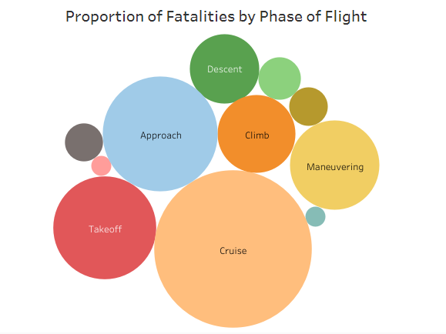

Slide 10
Recommendations
From our analysis, we identified two aircraft models that present the lowest risk.
These two airplanes therefore qualify for recommendation.
Make
Model
Boeing
B737-2H4
Boeing
NA-265-80

Slide 11


END

